Slide 1



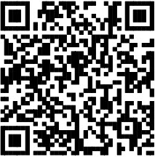

Real benefits that keep up with your real life.
Don’t miss your chance to enroll
The first step to choosing the right benefits is understanding the importance of each option.
Scan the QR code and find additional materials about MetLife’s great benefits available to you.
Questions?
Call MetLife Customer Support 1-800-GET-MET8 (1-800-438-6388)
Like most group benefit plans, benefit plans offered by MetLife and its affiliates contain certain exclusions, exceptions, waiting periods, reductions, limitations, and terms for keeping them in force. Please contact MetLife or your plan administrator for complete details.
Metropolitan Life Insurance Company | 200 Park Avenue | New York, NY 10166
©️ 2026 MetLife Services and Solutions, LLC
L5129575[exp0128][All States and][All Territories]

